Slide 1
A Project on Clustering

Slide 2
Overview of the project:-
We need to identify top countries that are in direst need of aid. our job is to categorize the countries using some socio-economic and health factors that determine the overall development of the country. Then we need to suggest the countries which the CEO needs to focus on the most.

Slide 3
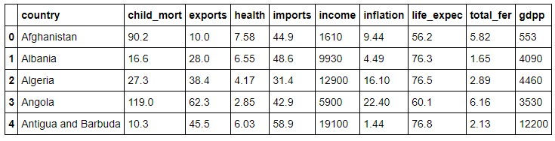
sample dataset:-

Slide 4
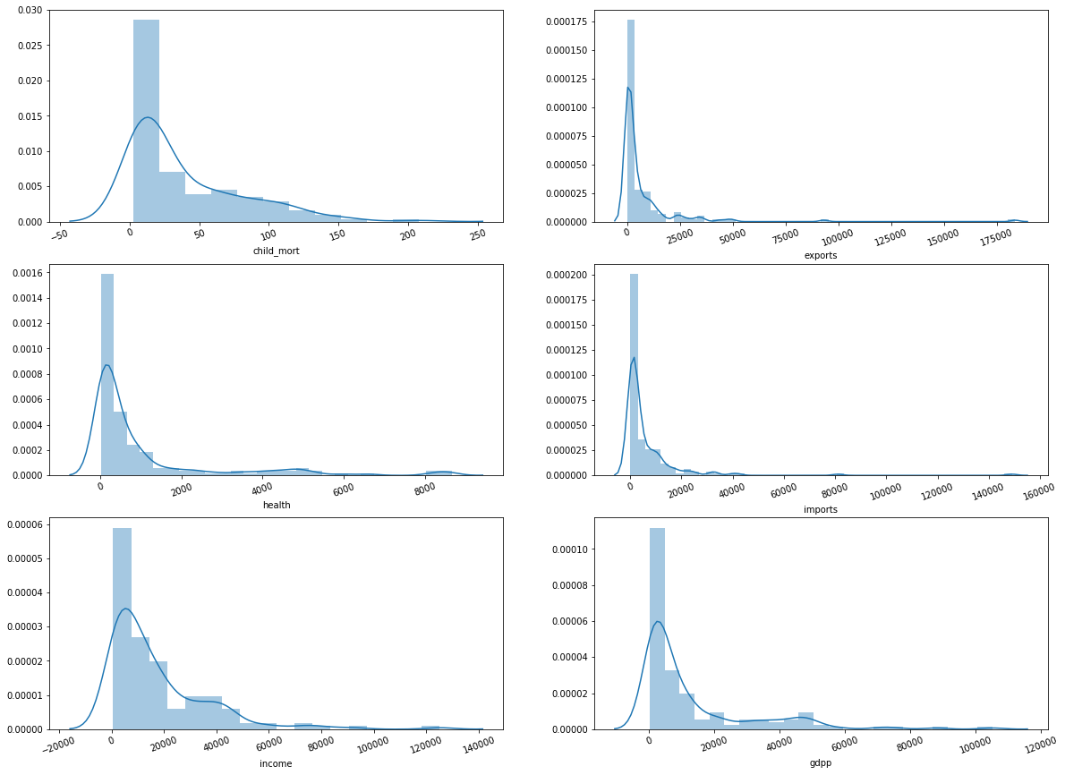
Parameters to be considered to understand the socio-economic and health status of countries:-
We can clearly see that child_mort, income and gdpp plots are not showing the normal distribution instead it suggests that there are not only one cluster of countries for these parameters.
This abnormal distribution in child_mort ,income and gdpp curve strongly recommends for a close analysis to understand the socio-economic condition to consider for health aid.

Slide 5
Types of Clustering techniques used:-
K-means clustering.
Hierarchical clustering.

Slide 6
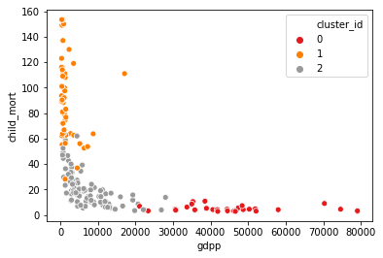
Clusters of countries based on gdpp and child_mort
Used k-means clustering technique to get the below plot:-
This scatter plot shows few crucial points:-
Cluster with orange color clearly shows that countries are having quite high child mortality rate and very low gdpp.
Cluster with Grey color shows that countries are having relatively lower child mortality rate and higher gdpp than the red ones.
Cluster with Red color shows very low child mortality rate and very high gdpp than the red ones.

Slide 7
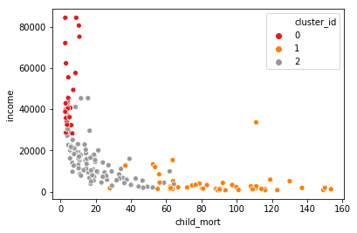
Clusters of countries based on child_mort and income
Used k-means clustering technique to get the below plot:-
This scatter plot shows few crucial points:-
Cluster with orange color clearly shows that countries are having quite high child mortality rate and very low income.
Cluster with Grey color shows that countries are having relatively lower child mortality rate and higher income than the red ones.
Cluster with Red color shows very low child mortality rate and very high income than the red ones.

Slide 8
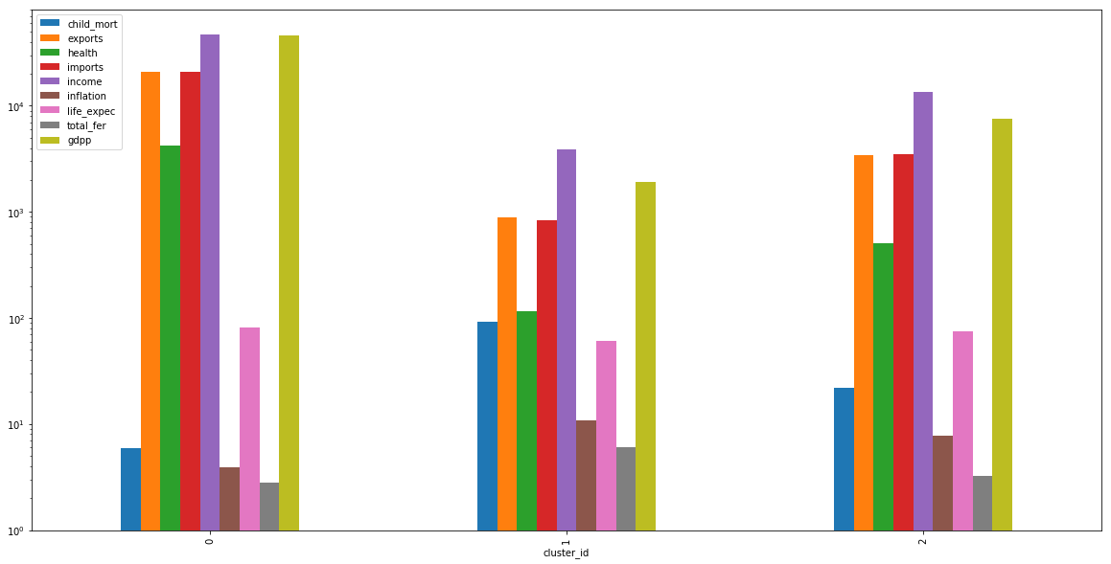
Various clusters of countries shown in a bar plot to further clarify the parameters:-
Used k-means clustering technique to get the below plot:-
Cluster_id 1 in the plot clearly draws our attention towards the highest child_mortality rate(which is shown in blue colour) which is really concerning.
Cluster_id 1 also shows the relatively lower gdpp and income compared to other two cluster 0 and 1.

Slide 9
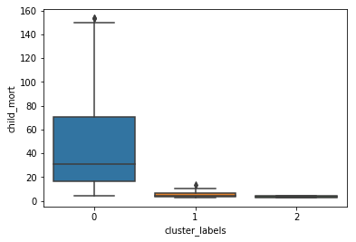
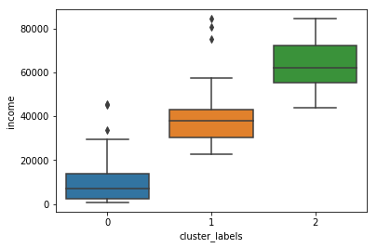
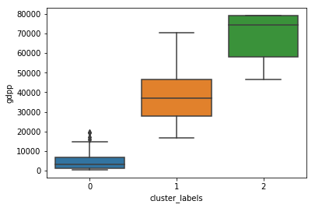
Used Hierarchical clustering technique to get to the list of countries in need of aid.
From all the above three box plot we can clearly understand that cluter_labels 0(in blue color) has very high child mortality rate, and very low gdpp and income rate.

Slide 10
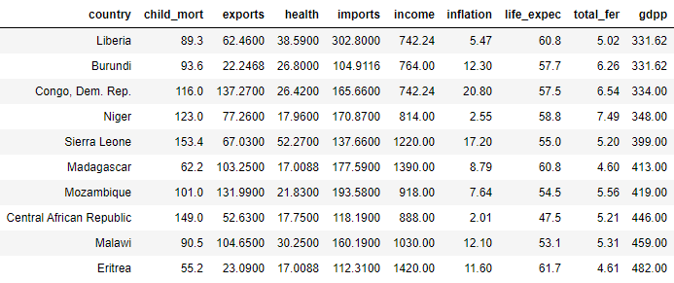
Final Analysis:-
Based on the gdpp, child mortality rate and income of the countries we got the following list of countries that are in urgent need of financial Aid by the HELP International (an international humanitarian NGO).

